Slide 1
ETCHING
Etching is used extensively in material processing for : delineating patterns, removing surface damage and contamination, and fabricating three-dimensional structures.
Etching is a chemical process whereby material is removed by a chemical reaction between the etchants and the material to be etched.
The enchant may he a chemical solution, in which case the etching process is called wet etching.
The etchant may be a plasma ; plasma-assisted etching is generally
referred to as dry etching. The term dry etching (also loosely referred to as plasma etching) is now used to denote several techniques that use plasma in the form of low pressure discharges.
Etching processes are characterized by .
Etch rate ; material thickness etched per unit time.
Etch selectivity ; a measure oj'how efl'ective the etch process is in removing the material to be etched while unaffecting other materials or films present in the wafer.
Etch uniformity.

Slide 2
Wet Etchine
Wet etching involves : (i) transporting the reactants by diffusion to the surface to be etched, (ii) chemical reactions at the surface, and (iii) reaction products transported awayfrom the surface, presumably by diffusion also.

Slide 3
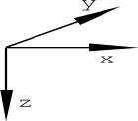
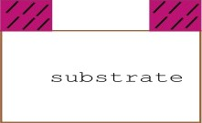


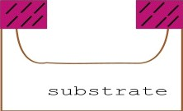
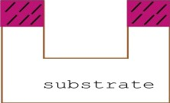
Directionalitv In An Etching Proceas

Slide 4
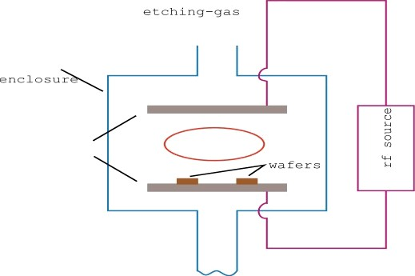
Dry Etchine
ink ed
electrodes
plasma
(1) Vacuum enclosure ,• (2) At least two electrically separated electrodes ,• (3) Provision for continuous introduction ofetching gas ,• (4) A port for pumping ,• (5) A source ofrfcoupled to the electrodes to create plasma.

Slide 5
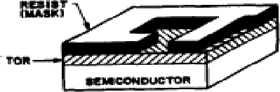
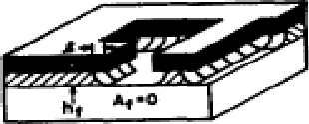
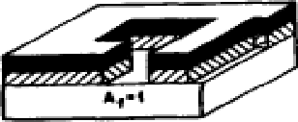
Etchin
Pattern Transfer : Wet Etchin
vs Dr

Slide 6
Etchin : Dama e As ects
Dry etching can be highly directional, however dry etching could be very damaging to etched surfaces and materials.

Slide 7
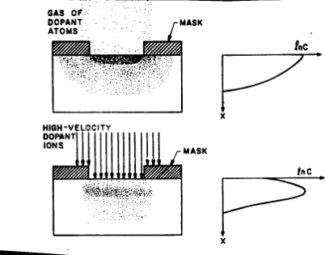
SEMICONDUCTOR DOPING
Diffusion and ion implantation are the two key processes used to introduce controlled amounts of dopants into semiconductors.
They are used to selectively dope the semiconductor substrate to produce either an n-type or p-type region.
In the diffusion method the dopant atoms are placed on the surface of the semiconductor by deposition
]’rom the gas phase oj'the dopant or
hy using doped-oxide sources.
In ion implantation method the dopant ions are implanted into the semiconductor hy means oJ’a high energy ion beam.

Slide 8
Diffusion ofdopants is typically done by placing semiconductor wafers in a fiirnace and passing an inert gas that contains the desired dopant through it.
The temperatures for doping range between 800 and 1200
C for Si.
The diffusivities ofcommonly used dopants are considerably smaller in silicon dioxide than in Si.
Hence silicon dioxide can be used as an effective mask against dopants.

Slide 9
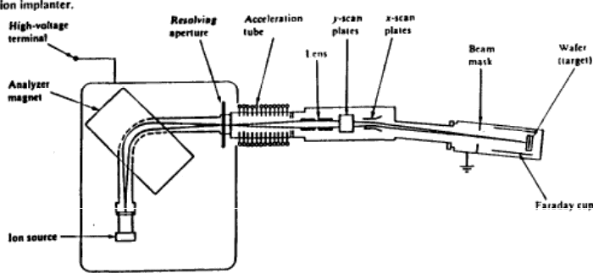
Ion implantation is throwing high energy ions at a substrate.
Commonly implanted elements are B (doping), P (doping), As (doping), 0 (buried oxide layers), or Si (amorphise polysilicon).
Typical energies 20 to 200 keV, and typical ion densities are 10” “ ” atoms7cm’ ofwafer surface.

Slide 10
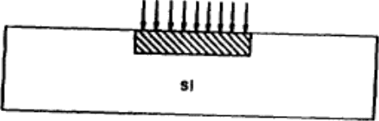
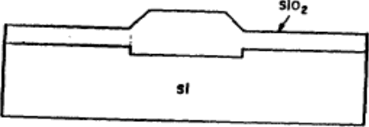
Ion Implantation : Pattern Generation
Ion implantation can be used to do resistless pattern generation : e. g., etch rate enhancement in silicon dioxide when it is implanted with various ions.
After silicon ions are implanted into the silicon substrate, followed by thermal oxidation, the thickness ofsilicon dioxide increase in the implanted regions.

